Slide 1
MACHINE LEARNING
MINI PROJECT
PRESENTATION:
Project Title: Real Time Face Recognition

Slide 2
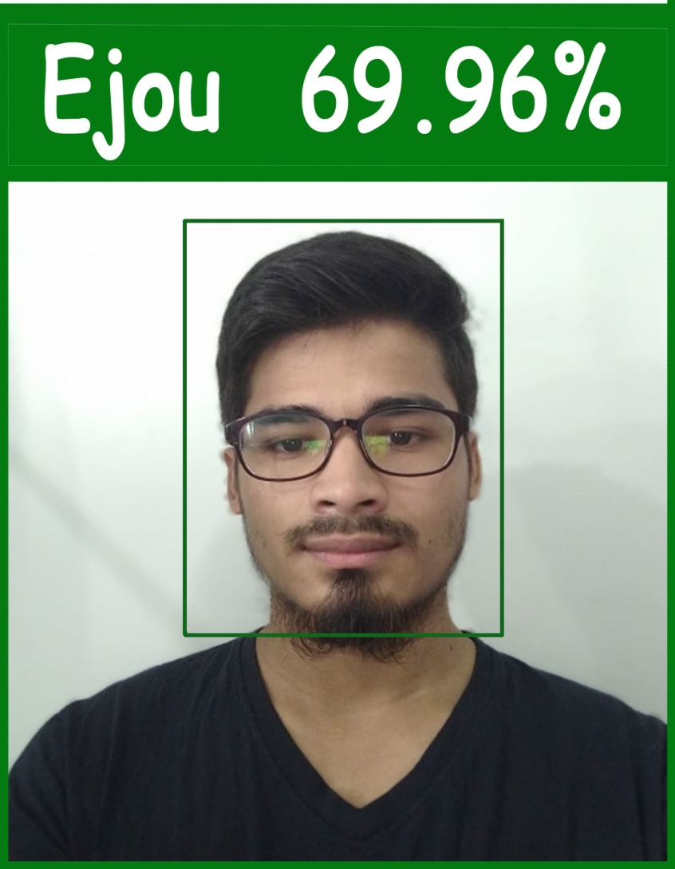
REAL TIME FACE RECOGNITION

Slide 3
The project is being computed in 3 (three) steps:
1. Dataset Collection
2. Training
3. Recognition(Face)

Slide 4
1. Dataset Collection
The device camera is turn on and the program searches for suitable areas with facial features.
Several snapshots are taken from the real time video camera.
The taken snapshots(with facial features) are served as dataset for the recognition.

Slide 5
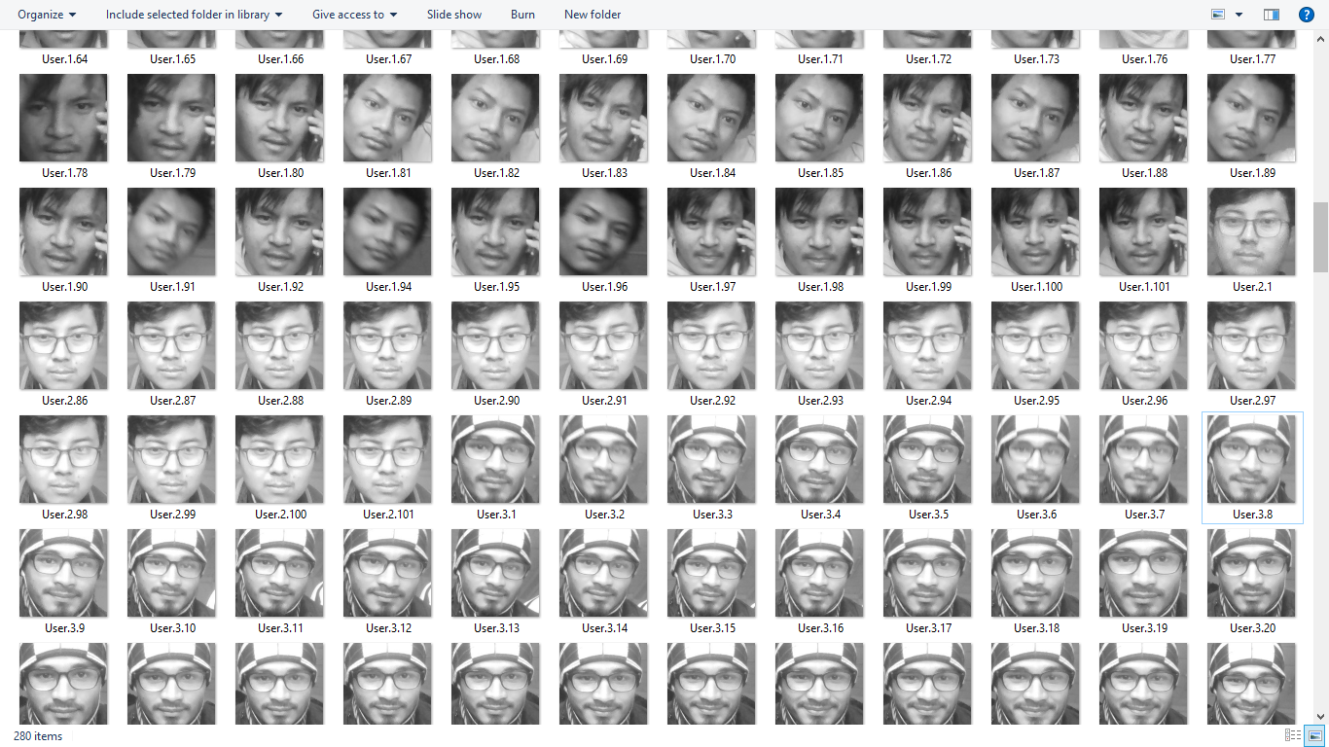
Dataset Sample

Slide 6
Training
The images are converted into grayscale format.
The resulted images(from above step) are converted into array representation considering the ‘ids’ of the images.
Then every images are saved as trained model in the trainer.yml file.

Slide 7
RECOGNITION
The device camera is turned on and is ready to detect faces.
The detected faces are scanned and checked if aligned with trained data.
Faces in front of the camera are detected and the corresponding label is displayed.

Slide 8
THANK YOU !

